Slide 1
Washoe COVID-19
Regional Information Center (RIC)

Slide 2
Washoe County Regional Information Center (RIC)
Established in March of 2020
Ensure ALL residents of Washoe County have access to critical pandemic related information
Build community trust in regional COVID-19 response efforts
Ensure access to timely and accurate COVID-19 vaccine related information
Facilitate communications resources among regional government entities, health partners, media, and regional stakeholders
Washoe County, City of Reno, City of Sparks, Washoe County Health District and 22 additional regional stakeholders

Slide 3
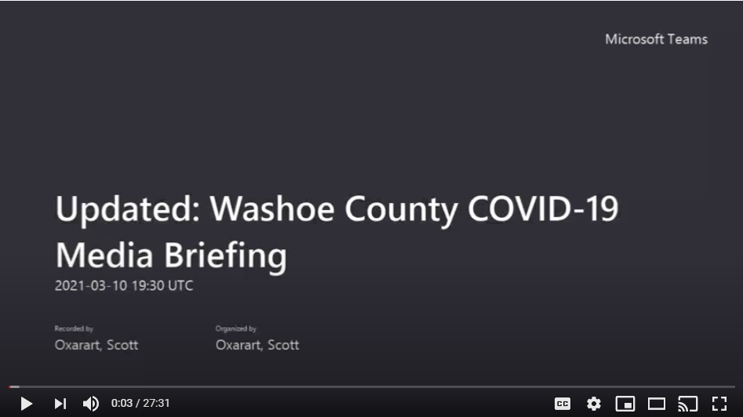
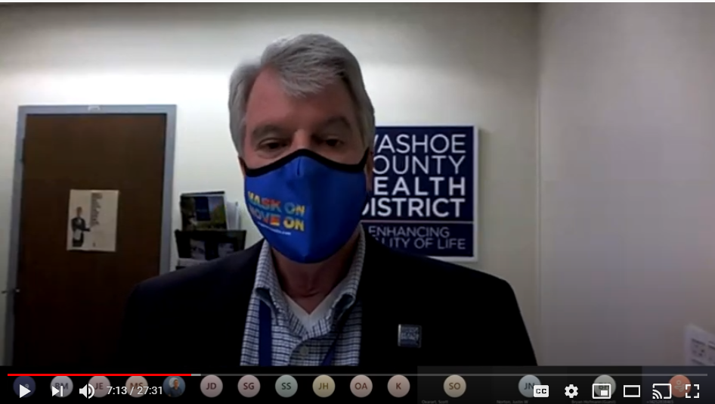
92
Media Briefings

Slide 4
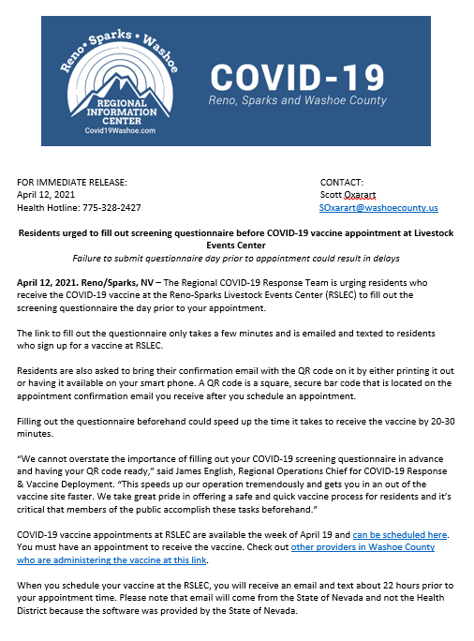
454
Press Releases

Slide 5
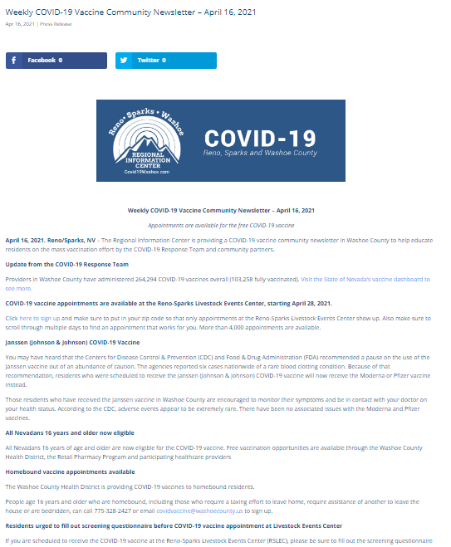
30,000 Newsletter Subscribers

Slide 6
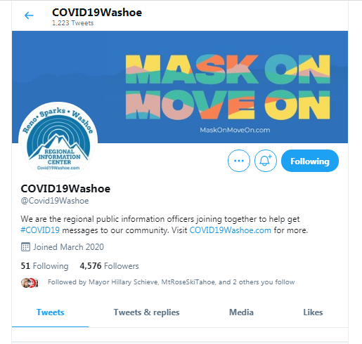
4,576
Twitter Followers
5.5M
Impressions

Slide 7
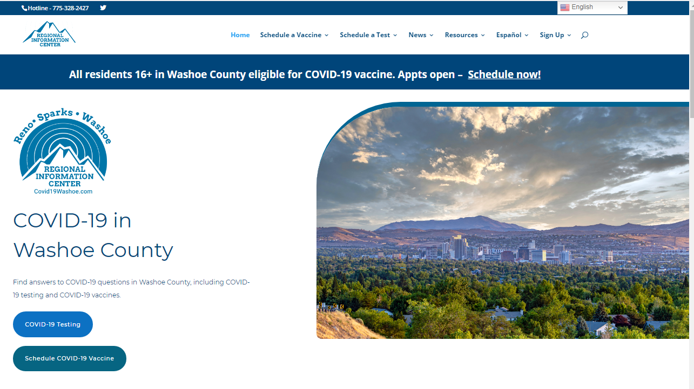
2.1M
Page Views

Slide 8
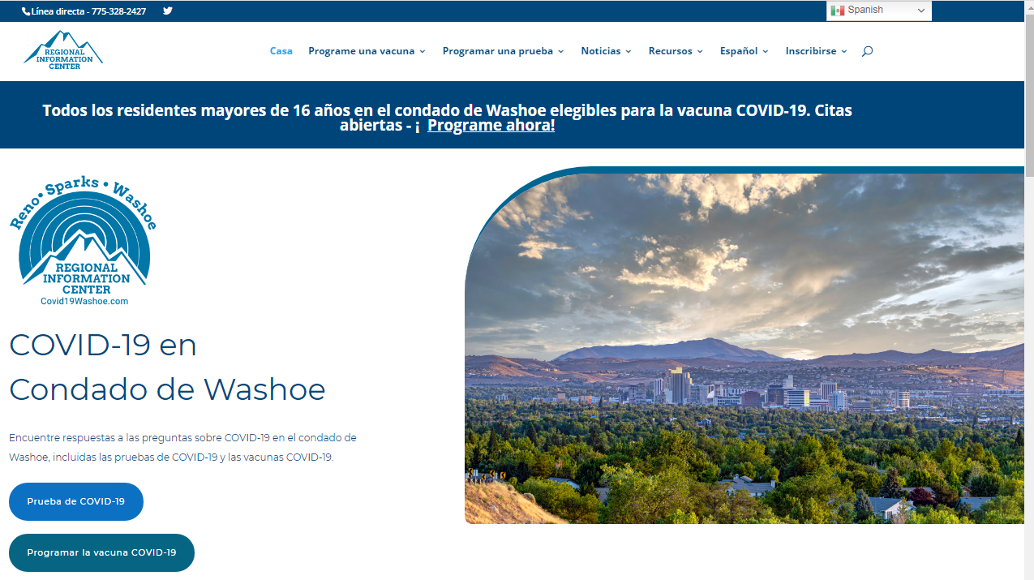
Information Accessibility
Materials and outreach in Spanish
Sign Language Interpreter and Closed Captioning when available

Slide 9
Regional campaign to decelerate the spread of COVID-19 in Washoe County
Focused messaging for LatinX, College Students/Millenials, Residents 65 and older, and Essential Employees and Business Owners
Partnered with KPS3, BVK, and IC Media Strategies

Slide 10
CAMPAIGN OVERVIEW VIDEO

Slide 11
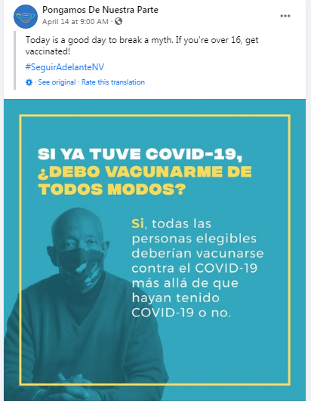
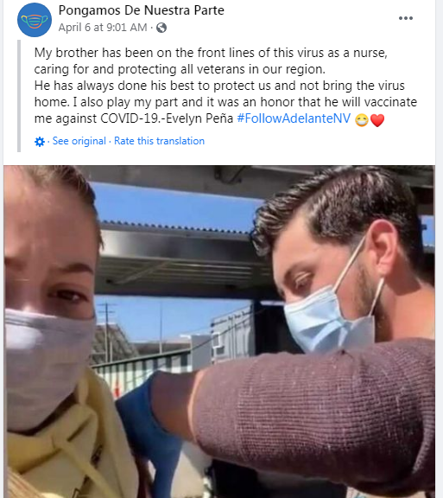
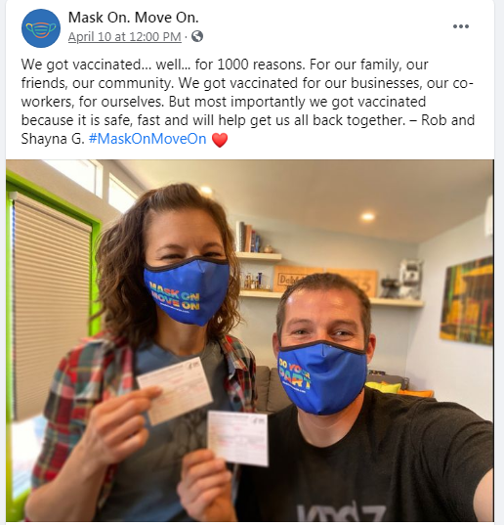
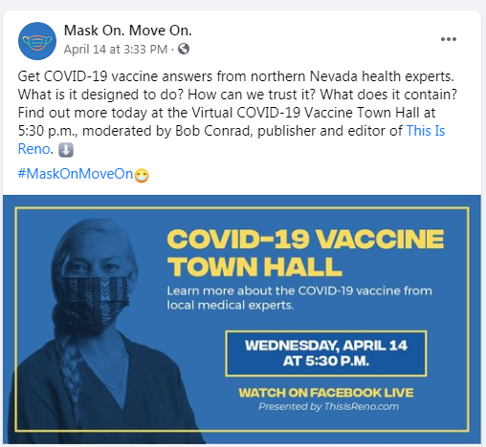
Mask On Move Forward
Shifting focus to COVID-19 Vaccines
Continued Public Relations and outreach efforts
Paid advertising to promote vaccine outreach
Town Halls to educate all community members about vaccine safety
Vaccine location and access
Partner with community leaders, business and organizations to share message

Slide 12
What’s Next?
Continue pandemic messaging following transfer of authority
Shared messaging and support for regional concerns
CARES Campus and support of unsheltered populations
Services and support for older Americans
Regional emergencies (i.e. wild fires, flooding)
Additional regional concerns

